Slide 1
Pete’s Pizzeria Case
John Draper
Assistant Professor – Clinical
Peg Pennington --author

Slide 2




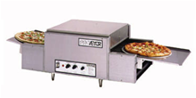



What Happened to Pete?
Pete’s Pizzeria has been in the pizza business for over 30 years.
Recently, a new competitor entered the market guaranteeing
delivery within 30 minutes of the order. The new competitor was
beginning to take business away from Pete. To understand
whether he is able to provide same counteroffer, Pete ran a quick
sample test and customer survey, the result show there is a broad
variation of the total delivery time. To save his business, he ask
Fisher College of business, Center of Operation Excellence for help.

Slide 3
DMAIC- A logical Flow of Problem Solving
D
M
A
I
C
Define
the Problem
Measure
the Process
Analyze
the Process
Improve
the Process
Control
the Process
To develop a clear project Charter based on the problems Pete’s Pizza faces
To understand the baseline and current performance of Pete’s Pizza
To find the root causes of the problems, and quantify the effects on process performance
To develop and select the best solutions to improve the process
problems
To ensure that solutions are implemented
Sustainably and the process are within robust control

Slide 4

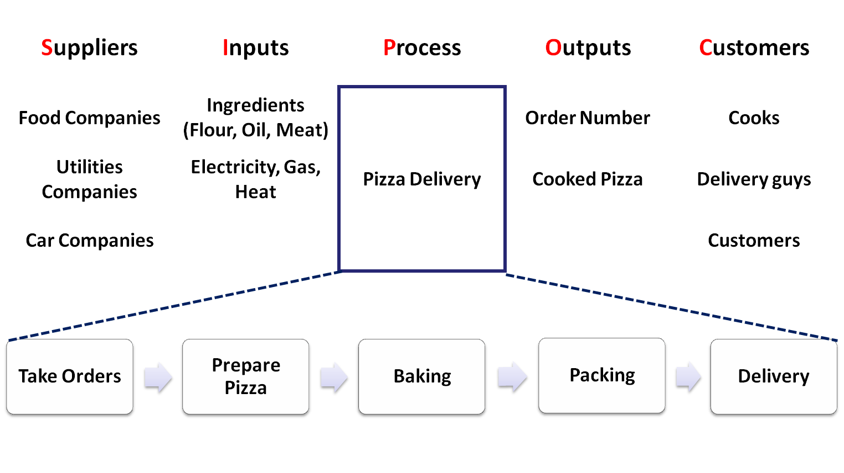
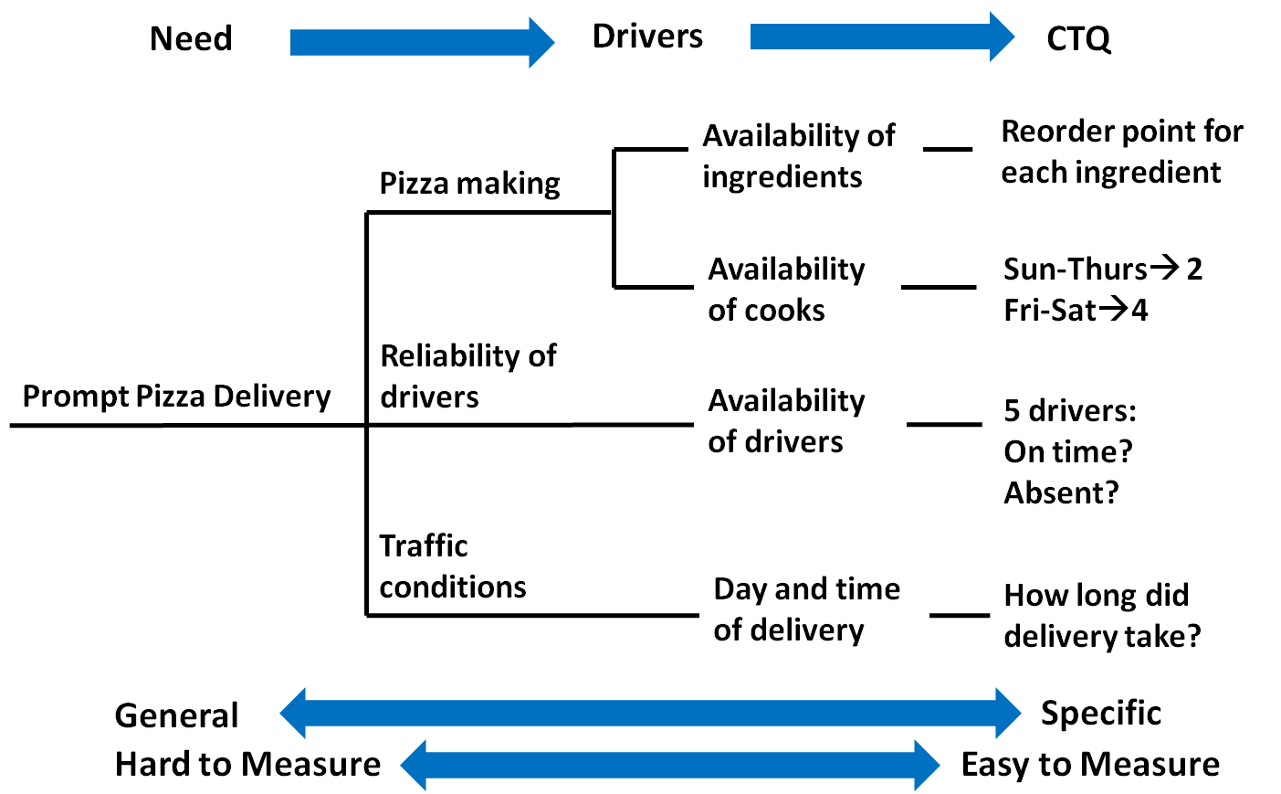
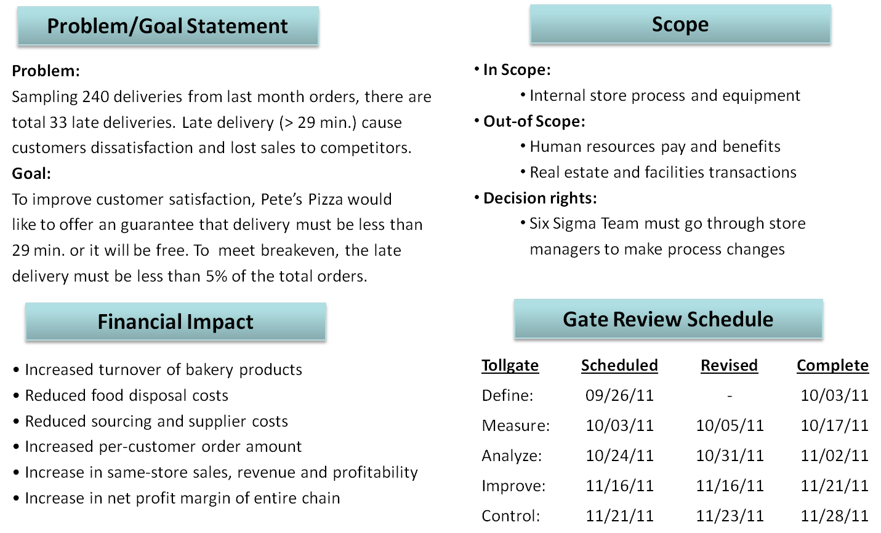
Define
Step 1. Define the problem
– Business Case
Step 3. Define the Process
– SIPOC Process Map
Facing competitor’s 30 min. delivery offer,
Pete’s Pizza prepare to offer a guarantee of delivering within 29 min. or free charge promotion
To limit the cost of free pizza, Pete’s Pizza must control its average delivery time at 25 min.
Step 2. Understand the Customer
– CTQ Trees
Step 4. Get Project Approval
– Project Charter

Slide 5
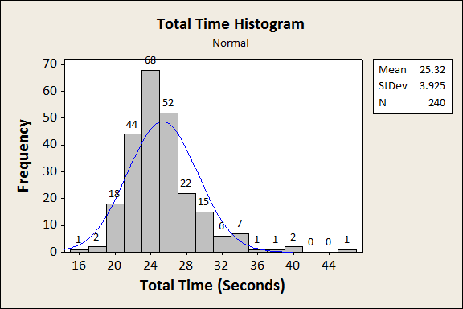
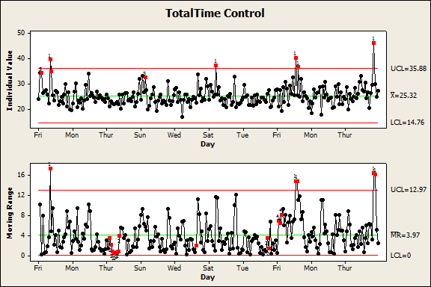
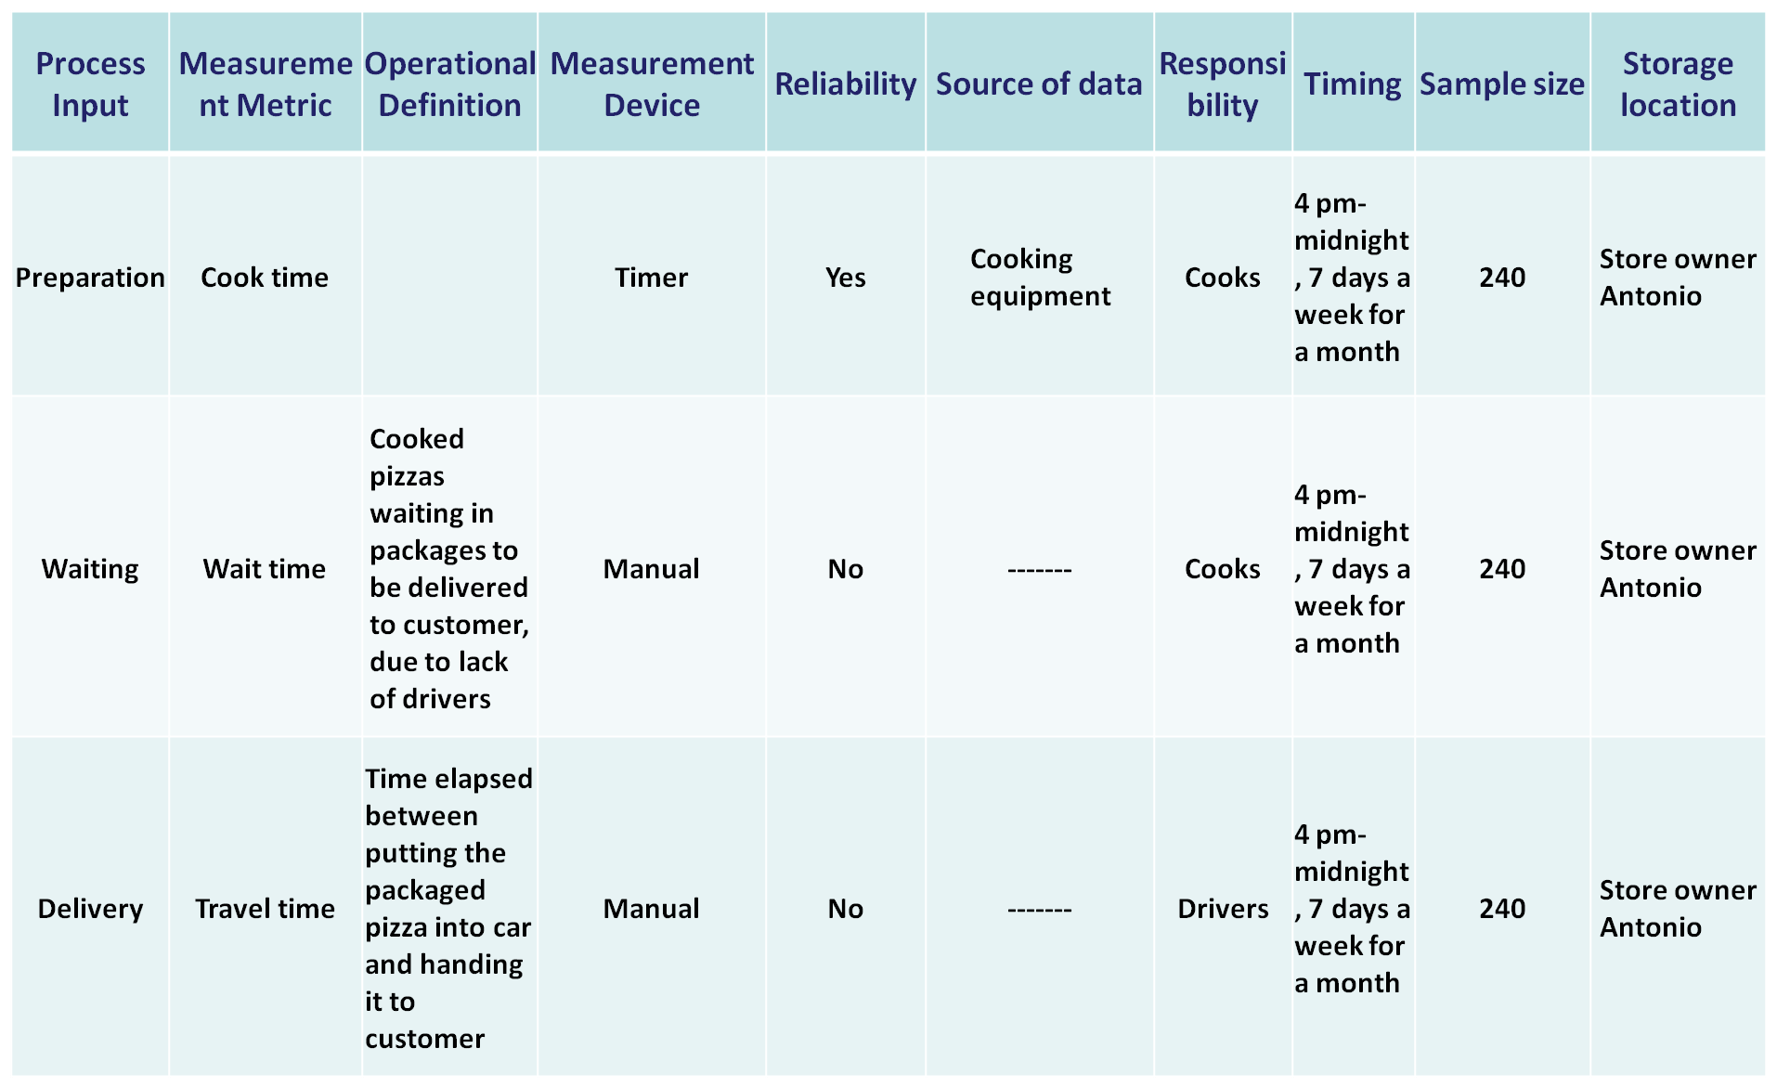
Measure
Step 5. Develop Process Measure
– Operational Definition
Step 7. Know Process behavior
– Distribution
– Control Chart
Total Pizza Delivery Time is the period from the
time the phone is answered to the moment the delivery person knocks on door.
Defects = Total Pizza Delivery Time > 29 seconds
Step 6. Collect Process Data
– Data Collection Plan
Step 8. Baseline Process Capability
– Sigma Level /DPMO
Numbers of late deliveries: 240
Numbers of late deliveries : 33
DPMO
=(No. of Defects x 1,000,000)
/((No. of Defect Opportunities/Unit) x No. of Units))
= (33*1,000,000)/(1*240)
= 137,500
Sigma Level: 2.6

Slide 6
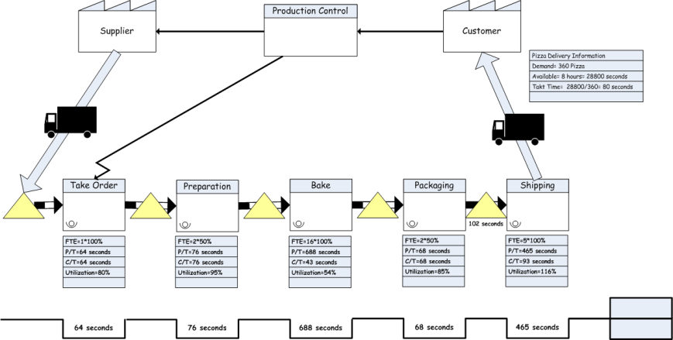
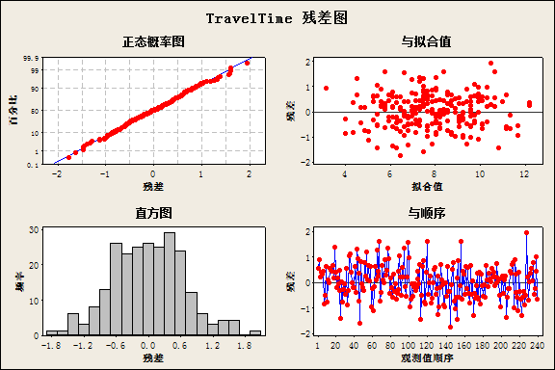
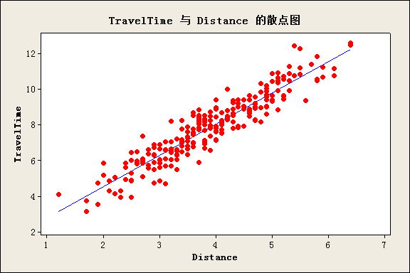
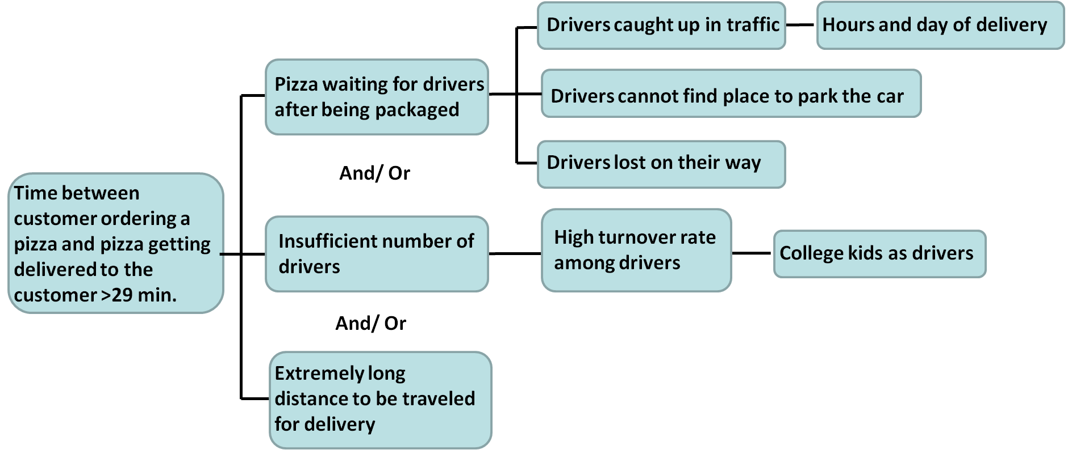
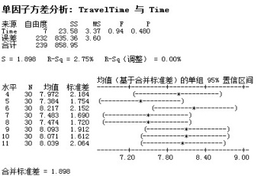
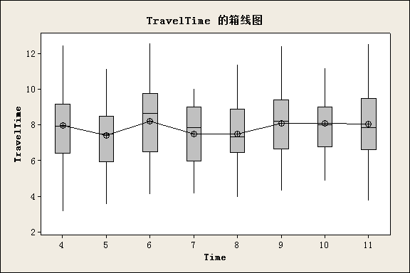
Analyze
Step 9. Analyze the process
– Value Stream Maps
Step 11. Verify root causes
– Linear Regression
– Hypothesis Testing
Does Long distance to be traveled for delivery?
Regression Equation
Travel Time = 1.03 + 1.75 Distance
Variables Coefficient StDev . T P
Constant 1.0282 0.1718 5.98 0.000
Distance 1.74962 0.04270 40.97 0.000
S = 0.669440 R-Sq = 87.6% R-Sq（Adj.) = 87.5%
Step 10. Find potential root causes
– Cause and Effect Maps
Does hour of the day delivery?
Compare the difference of travel
time across each hour of the day
to see if there is a significant
difference
Variable Data ->
More than two sample->
ANOVA-> F-test ANOVA
p=0.48>0.05
There is no significant difference

Slide 7
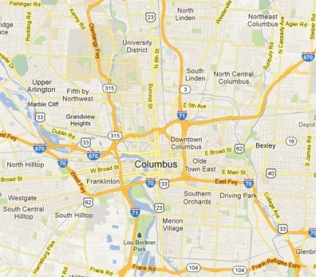

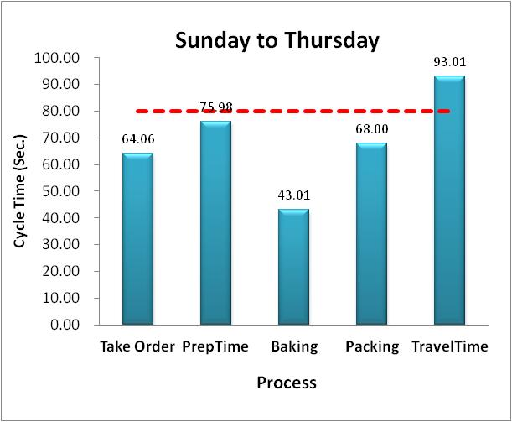
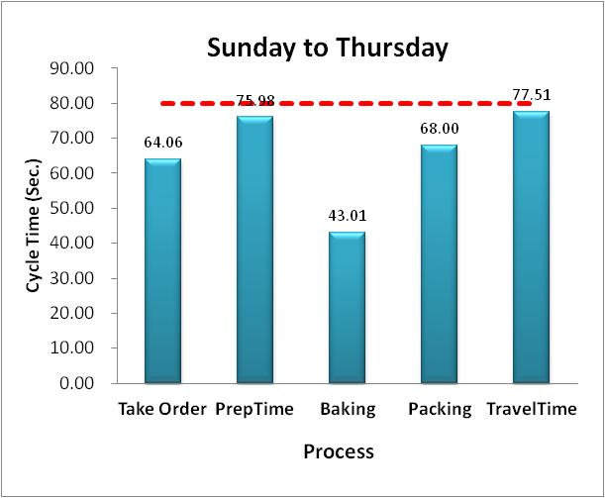
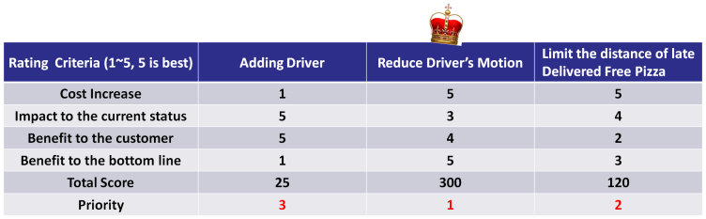
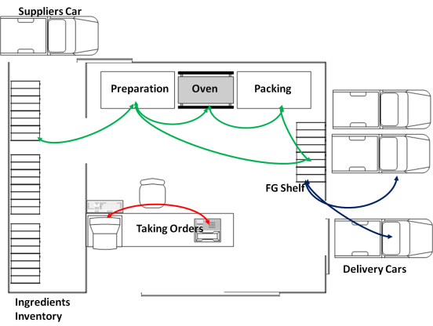
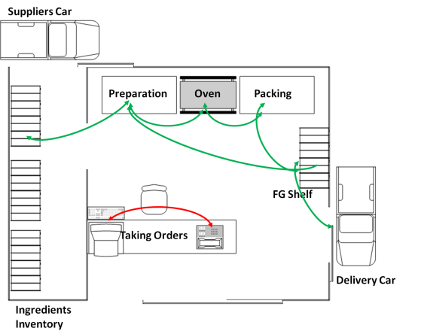
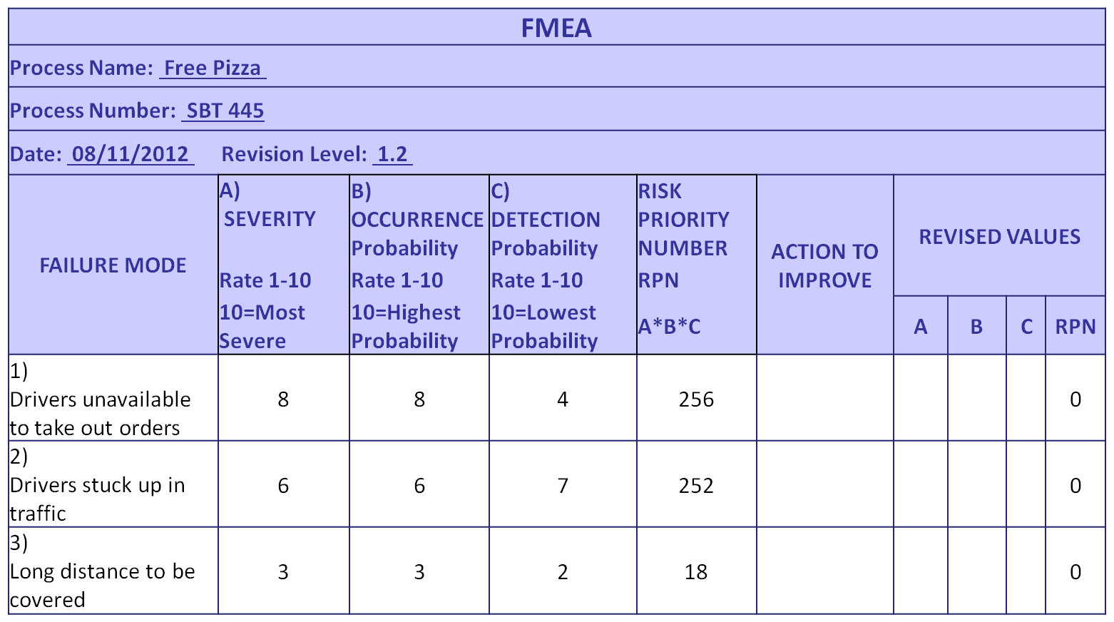
Improve
Step 12. Generate Potential Solutions
– Line Balancing
– Spaghetti Diagram
Based on the regression
Model , Travel Time
= 1.03 + 1.75 Distance
and current baking time . Pete
can decide within what distance
“Free Pizza policy” can be applied
Takt Time: 80 seconds
Step 13. Select the best solutions
– Solutions Prioritizer
Step 14. Assess the risk – FMEA
Add one driver to the delivery team
Reduce the motion needed for driver getting pizzas
Limiting the delivery Region
Step 15. Pilot studies and implement
Pete Pizza chose one day to test the solutions; if good , it will gradually expand the implementation

Slide 8
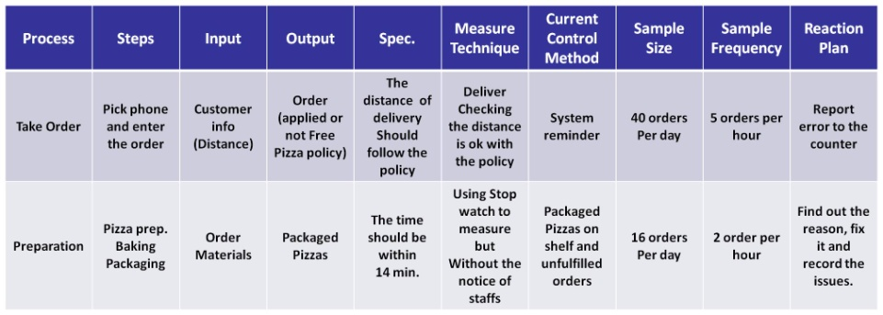


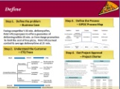
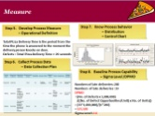
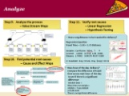
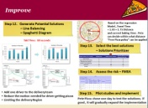
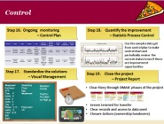
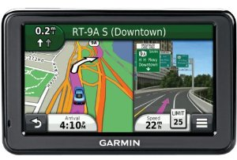
Control
Step 16. Ongoing monitoring
– Control Plan
Step 18. Quantify the improvement
– Statistic Process Control
Use the samples data got from control plan to make control chart and periodically review the current status to see if there are improvement opportunities
Step 17. Standardize the solutions
– Visual Management
Step 19. Close the project
– Project Report
Manpower
Delivery: 4/5
Tom V
Kevin V
Alex V
John V
Jay X
Phone: 1/1
Larry V
Chef: 2/2
Bill
Bart
Inventory
Flour
Egg
Mushroom
Pizza wait
10
Weather: Cloudy
Traffic:
Accident on High st.
Clear Story through DMAIC phases of the project
Lessen Learned for transfer
Clear records and access to data used
Closure Actions (ownership handovers)

